Slide 1
GDPR
Direct Marketing List Rental Procedure
For guidance purposes only

Slide 2
Contents
Introduction
Definitions
Core principles of GDPR/Data Protection Act 2018
Key areas to consider. Individuals’ rights
Who is a Data Controller or Data Processor?
Who needs a Data Processing Contract?
Legitimate Interest Assessment
Due Diligence for List Owner
Due Diligence for List User
Data protection and Brexit – ICO advice for organisations
Summary

Slide 3
Introduction
This document has been designed to provide guidance for List Owners, List Managers and List Brokers when carrying out Due Diligence in relation to the following tasks;
When a List Owner sells direct or appoints a List Manager to represent the postal marketing list.
When considering representing a List Owner’s postal marketing list for use by third parties (as a List Manager).
When a List Manager is considering representing a List Owner’s postal marketing list for use by third parties.
When a List Manager is renting out a postal marketing list to a List User or other third party.
When a List Broker is buying in data from List Owners or other third parties on behalf of the List Broker’s client.
It is intended to standardise the process, using common templates when both buying or selling data.

Slide 4
Definitions
Data – personal data used for postal direct marketing purposes.
List Owner – the Controller who collects the data
List User – the Controller who will use the data for direct marketing purposes.
List Manager – An organisation or consultant who facilitates the sale of the data for 3rd party marketing purposes under contract by the List Owner.
List Broker – An organisation or consultant who is contracted by the List User to source and recommend suitable lists for the direct marketing purposes.
Anonymous data – data which does not relate to an identified or identifiable natural person or to Data rendered anonymous in such a manner that the data subject is no longer identifiable.
Consent - according to GDPR/Data Protection Act 2018, consent, “means any freely given, specific, informed and unambiguous indication of the data subject’s wishes by which he or she, by a statement or by a clear affirmative action, signifies agreement to the processing of personal data relating to him or her”.
Controller - the organisation or individual that determines the purpose for which the personal data is processed.

Slide 5
Definitions
Legitimate interest (LI) - a legal basis that can be used to process personal data for direct marketing in certain circumstances. As well as providing the right for individuals to object to the processing of personal data based on LI, the GDPR sets out strict criteria for organisations that seek to rely on LI. These include establishing that the processing is necessary and that a balancing test has been conducted.
Personal data - any information that can be used to identify a person is personal data. For example, names and email addresses are personal data because they reveal someone’s identity. The GDPR expands the definition of personal data to include IP addresses and online identifiers, like cookies.
Personal data breach - a breach of security leading to the accidental or unlawful destruction, loss, alteration, unauthorised disclosure of, or access to, personal data transmitted, stored or otherwise processed. This could be the result of hacking by outside groups or because an employee made a mistake or a deliberate act by an employee.
Data-protection-by-design - is designing policies, procedures and systems with data protection/privacy built in from the start of the design/development process so that they are GDPR/Data Protection Act 2018 compliant.

Slide 6
Definitions
Data-protection-by-default - means that organisations should ensure that personal data is processed with the highest privacy protection. For example in a direct marketing context, only the data necessary for direct marketing should be processed. The personal data should only be retained for the shortest period possible in respect of the direct marketing activities and access to the personal data should be limited to only those staff members who need to access it in the context of direct marketing.
Processing - any operation performed on personal data, whether or not by automated measures such as collection, recording, organising, structuring, storing, adaptation or alteration, retrieval consultation, use, disclosure by transmission, otherwise making available, alignment or combination, restriction, erasure or destruction transmission, dissemination, or otherwise making available, alignment or combination.
Processor - The organisation that processes personal data only on the instruction of the data controller. For example, an email services organisation only processes personal data in line with what their client tells them and this means they’re a data processor.
Profiling - Any type of processing of personal data that evaluates the characteristics of someone in order to make a decision. Marketing segmentation or targeting is a type of profiling.
Pseudonymisation – the method of making personal data into such a form that it can no longer be attributable to a specific individual without the use of additional information. The additional information must be kept separately and subject to technical and or organisational measures to prevent re-identication.

Slide 7
Definitions
Special categories of personal data - the processing of personal data that reveals: “racial or ethnic origin, political opinions, religious or philosophical beliefs, or trade union membership, and the processing of genetic data, biometric data for the purpose of uniquely identifying a natural person, data concerning health or data concerning a natural person’s sex life or sexual orientation”. The processing of this data is subject to stricter requirements because of its sensitive nature.
Supervisory authority - an independent public authority responsible for enforcing the GDPR. The Information Commissioner’s Office (ICO) are the supervisory authority in the UK.
Third party - any organisation or individual that is not the data controller or processor that has a legal basis to process personal data.

Slide 8
Core principles of GDPR
Article 5 of the GDPR requires that personal data shall be:
(a) processed lawfully, fairly and in a transparent manner in relation to individuals;
(b) collected for specified, explicit and legitimate purposes and not further processed in a manner that is incompatible with those purposes; further processing for archiving purposes in the public interest, scientific or historical research purposes or statistical purposes shall not be considered to be incompatible with the initial purposes;
(c) adequate, relevant and limited to what is necessary in relation to the purposes for which they are processed;
(d) accurate and, where necessary, kept up to date; every reasonable step must be taken to ensure that personal data that are inaccurate, having regard to the purposes for which they are processed, are erased or rectified without delay;
(e) kept in a form which permits identification of data subjects for no longer than is necessary for the purposes for which the personal data are processed; personal data may be stored for longer periods insofar as the personal data will be processed solely for archiving purposes in the public interest, scientific or historical research purposes or statistical purposes subject to implementation of the appropriate technical and organisational measures required by the GDPR in order to safeguard the rights and freedoms of individuals;
(f) processed in a manner that ensures appropriate security of the personal data, including protection against unauthorised or unlawful processing and against accidental loss, destruction or damage, using appropriate technical or organisational measures.
Article 5(2) requires that
“the controller shall be responsible for, and be able to demonstrate, compliance with the principles.”

Slide 9
Key areas to consider. Individuals’ rights.
The right to be informed
Individuals have the right to be informed about the collection and use of their personal data. An organisation must provide individuals with privacy information including :
the purposes for processing their personal information
How long they will keep the personal information?
What other organisations they will share the personal information with?
This privacy information must be provided at the time of data collection.
If your organisation obtains personal information from another source, for example by renting or purchasing a list then you must provide individuals with the privacy information at the time you first contact them or at the latest one month after you purchased/rented the list.
The right of access
An organisation can no longer charge a fee for responding to subject access request.
The time limit has been reduced from 40 days to 30 days.

Slide 10
Key areas to consider. Individuals’ rights.
Under the GDPR, individuals will have the right to obtain:
confirmation that their data is being processed;
access to their personal data;
and other supplementary information – this largely corresponds to the information that should be provided in a privacy notice.
These are similar to existing subject access rights under the DPA.
The right to rectification
Individuals are entitled to have personal data rectified if it is inaccurate or incomplete.
If you have disclosed the personal data in question to third parties, you must inform them of the rectification where possible. You must also inform the individuals about the third parties to whom the data has been disclosed where appropriate.

Slide 11
Key areas to consider. Individuals’ rights.
The right to erasure
The right to erasure is also known as ‘the right to be forgotten’. The broad principle underpinning this right is to enable an individual to request the deletion or removal of personal data where there is no compelling reason for its continued processing including retention. You can keep the minimum level of detail on an individual for suppression purposes!
The right to restrict processing
Under the Data Protection Act 1998, individuals have a right to ‘block’ or suppress processing of personal data. The restriction of processing under GDPR/Data Protection Act 2018 is similar. When processing is restricted, you are permitted to store the personal data, but not further process it. You can retain just enough information about the individual to ensure that the restriction is respected in future.
The right to data portability
The right to data portability allows individuals to obtain and reuse their personal data for their own purposes across different services. It allows them to move, copy or transfer personal data easily from one IT environment to another in a safe and secure way, without hindrance to usability. Some organisations in the UK already offer data portability through the midata and similar initiatives which allow individuals to view, access and use their personal consumption and transaction data in a way that is portable and safe. It enables consumers to take advantage of applications and services which can use this data to find them a better deal, or help them understand their spending habits.

Slide 12
Key areas to consider. Individuals’ rights.
The right to object.
An individual has the right to object to any processing that uses legitimate interests. This should be communicated at the point of data collection, perhaps via an opt-out box or link for marketing communications. For other processing, such as profiling, you might consider an email address or other mechanism. It is advisable that the opt-out is provided via the same marketing channel. So in the case of postal marketing the recipient should be given an opportunity to unsubscribe/opt-out by post For other processing such as profiling which falls outside the definition of automated decision making you might consider an email address or other mechanism.
In particular there is an absolute right to object to direct marketing and this must be respected by organisations. Clear opt-outs should be available when personal data is collected and in all future communications, whichever legal ground under the GDPR an organisation is using for its direct marketing activities.
Rights in relation to automated decision making and profiling.
An individual can object to a decision made solely on an automated basis, which has a legal or similarly significant effect. It may only happen if the decision being made is necessary for contractual reasons, or authorised by EU or UK law applicable to the controller, or based on the individuals explicit consent. Furthermore, the organisation must identify whether any processing falls under Article 22 of GDPR, give individuals information about processing activity, allow them to challenge a decision easily and regularly check its systems are working.

Slide 13
Key areas to consider. Individuals’ rights.
It has been confirmed that the majority of postal direct marketing falls outside the scope of automated decision making because the receipt of or non - receipt of a postal direct marketing is unlikely to produce a legal effect or similarly significantly affect an individual. Even if the profiling falls outside the definition of automated decision-making, organisations must still inform recipients that profiling is being carried out for example by including it in their privacy policy in order to meet the privacy information requirements.

Slide 14
Who is a Data Controller or Data Processor
The ICO state; “If an organisation is not processing any personal data then the GDPR won’t apply (although it will depend on whether these companies are collecting, holding, passing personal data onto the ‘list user’). Ultimately, if the organisation is confident that it is not processing personal data then GDPR doesn’t apply and they are neither a data controller or processor for that process.”
The DMA state; “Even if the data does not pass through the list broker’s systems the list broker may still be a Processor.
For example if a list broker rents data from a list owner or a list manager on behalf of an end user and then the end user instructs the data broker to forward the data directly from the list owner to the end user’s mailing house then even though the data never touches the list broker the list broker may be a processor because of the contractual relationship between the list broker and the end user.
A list manager or broker must satisfy themselves if they are a Processor or not based on their contractual relationship with the Controller/s.
Article 4, Definitions states: For the purpose of this Regulation, processing means any operation or set of operations which is performed on personal data, whether or not by automated means, such as collection, recording, organisation, structuring, storage, adaptions or alteration, retrieval, consultation, use, disclosure by transmission, dissemination or otherwise making available, alignment or combination, restriction, erasure or destruction. So in the example above we consider ourselves as a processor!

Slide 15
Who is a Data Controller or Data Processor
Most List Managers/Brokers are likely to fall into the definition of processors. The ICO has produced a checklist for organisations to determine whether they are controllers or processors at
https://ico.org.uk/for-organisations/guide-to-the-general-data-protection-regulation-gdpr/key-definitions/controllers-and-processors/
More detailed guidance about controllers and processors is available at
https://ico.org.uk/for-organisations/guide-to-the-general-data-protection-regulation-gdpr/controllers-and-processors/
The ICO has produced detailed guidance on contracts and liabilities between controllers and processors available at
https://ico.org.uk/for-organisations/guide-to-the-general-data-protection-regulation-gdpr/contracts-and-liabilities-between-controllers-and-processors-multi/
Regardless of a list manager or broker being a processor or not, we recommend they carry out due diligence when renting data to or from a controller as outlined in this document.

Slide 16
Who needs a Data Processing Contract
Taking a typical list rental transaction, there are usually four companies involved.
List Owner – Controller
List Manager – on behalf of the List Owner/Controller
List Broker – on behalf of the List User/Controller
List User – Controller
We asked the DMA to clarify who needs a Data Processing Contract (Appendix 6) with whom in the above scenario.
Answer - There would be a data processing agreement with the List Owner as controller and List Manager as processor and then another agreement between the List User as controller and List Broker as processor.
There may be circumstances where additional parties are involved within this process such as an advertising agency, printer, a bureau providing suppression services or mailing house who contract to a List User who in-turn appoint the List Broker. If a data processing contract already exists between a Controller and Processer, other parties may be able to be named within the same agreement as a Sub-Processor. This will depend on whether the Controller choses the Sub- Processor or not. If the Controller leaves the decision as to which Sub-Processor to use up to the discretion of the Processor then it is almost certain that the Processor will need its own data processing contract with the Sub-Processor. In this case the Controller will act as A Controller with regards to the transfer of data to the Sub-Processor. The Processor will need to check that it can sub-contract to the Sub-Processor under the terms of its agreement with the Controller.

Slide 17
Legitimate Interest Assessment
Legitimate Interest Assessment (LIA)
Any organisation using Legitimate Interest as their legal basis for processing personal data under GDPR/Data Protection Act 2018 need to carry out a LIA. As a List Owner and List User are both Controllers, they both need to have carried out a LIA. The LIst Owner will need to carry out an LIA with regard to the transfer of the list to the List user. The List User will need to carry out an LIA with regard to its use of the list for its own marketing purposes.
There are three stages to this assessment: Identify a legitimate interest, Carry out a necessity test and Carry out a balancing test.
Identify a Legitimate Interest - this is where an organisation contemplates the purpose of data the legitimate interest can be carried out without the use of personal information. In most cases the personal data is essential to ensure the marketing communication reaches the right recipient. In marketing, this means communicating with customers or prospects to help promote or sell products or services.
A necessity test - having identified legitimate interests, an organisation must then decide whether a processing activity - planned or under way - is necessary.
Balancing test - is balancing the right of the organisation against the data protection rights of the individual. In the case of postal marketing the balancing test can usually be met by providing the recipient with the opportunity to unsubscribe/opt-out of further postal marketing.
Marketers need to record their decision making and the logic used to reach that decision in respect of all three stages of the LIA, we have provided a LIA Template*, (Appendix 7).
*Source: Data Protection Network, Guidance on the use of Legitimate Interests under the EU General Data Protection Regulation (version 2).

Slide 18
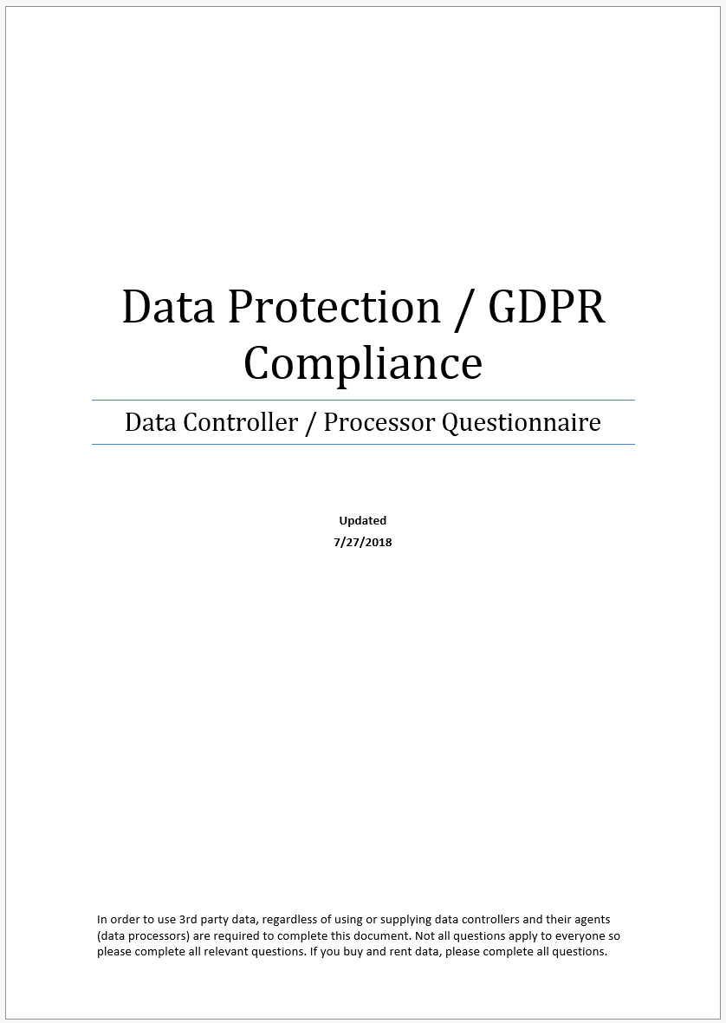
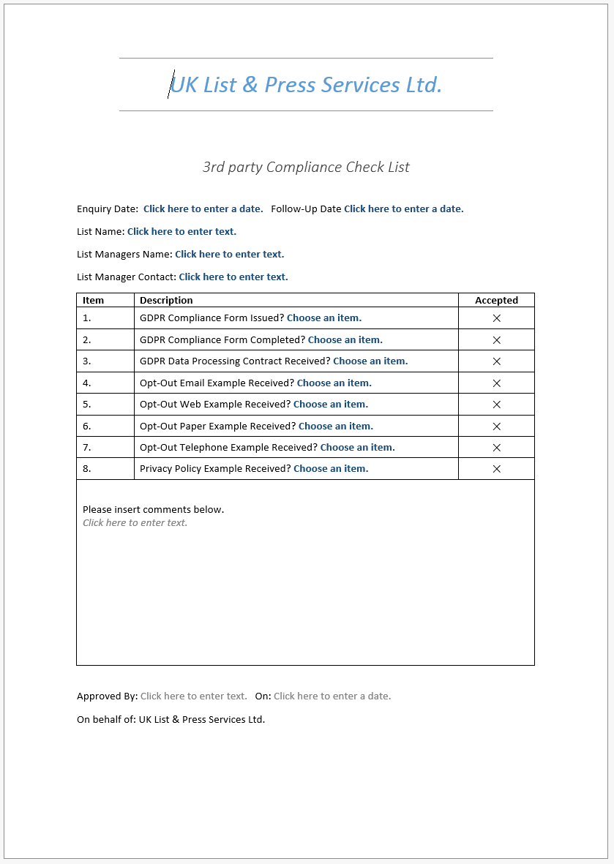
Due Diligence for List Owners
When considering a postal marketing list whether to represent or to rent on behalf of a third party you are required to carry out due diligence to ensure, to the best of your ability that the collection and processing of the data complies with GDPR and the Data Protection Act 2018.
There are two documents which will assist this process, they are;
Appendix 1: Appendix 2:

Slide 19
Appendix 1 Data Protection/GDPR Compliance form
This document is to be completed by data processors and controllers when renting postal data to a third party. This applies as follows.
All List Owners, (Data Controllers) are required to complete this document so that it can provided to third parties when they carry out their due diligence.
3rd party List Owners, (Controllers) and their List Managers, (Processors) are also required to complete this document in order to satisfy due diligence.
All sections need to be completed.
The complete due diligence process should be reviewed annually. You should also consider how you check if any changes in their processes have changed in the interim. You may wish to request confirmation of this on each order form you send to them.

Slide 20
Appendix 2 Third Party Compliance check list
This document ensures each step within the due diligence process is completed satisfactorily and the process is consistent for each postal marketing list.
All compliance forms, mailing/coupon samples should be stored electronically or otherwise and the locations of these documents noted within this form.
The follow-up/review date should be set one year from the initial enquiry date.
All sections need to be completed.

Slide 21
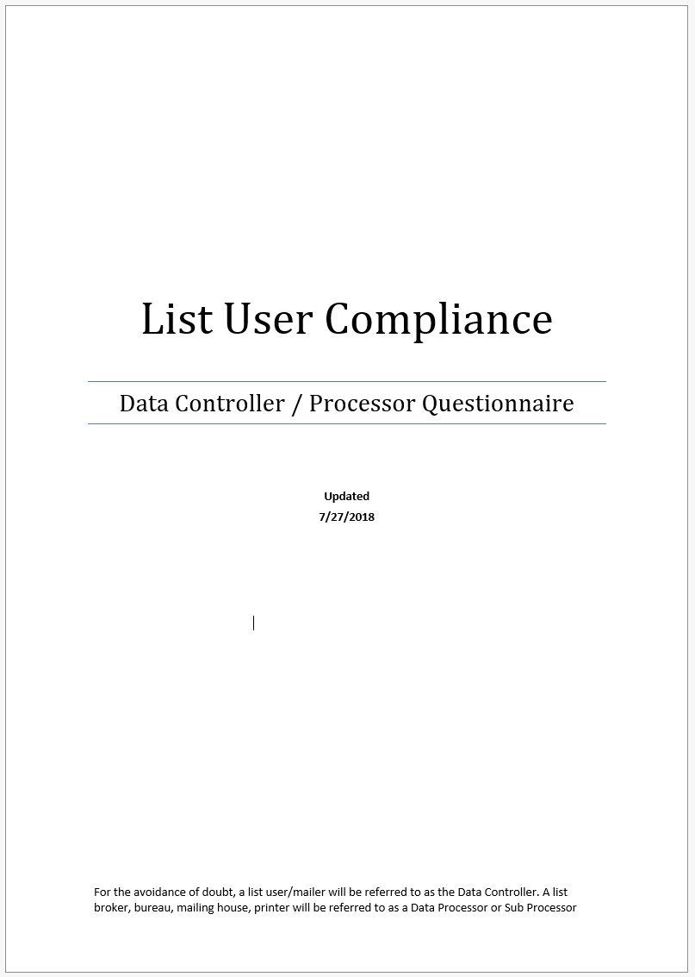
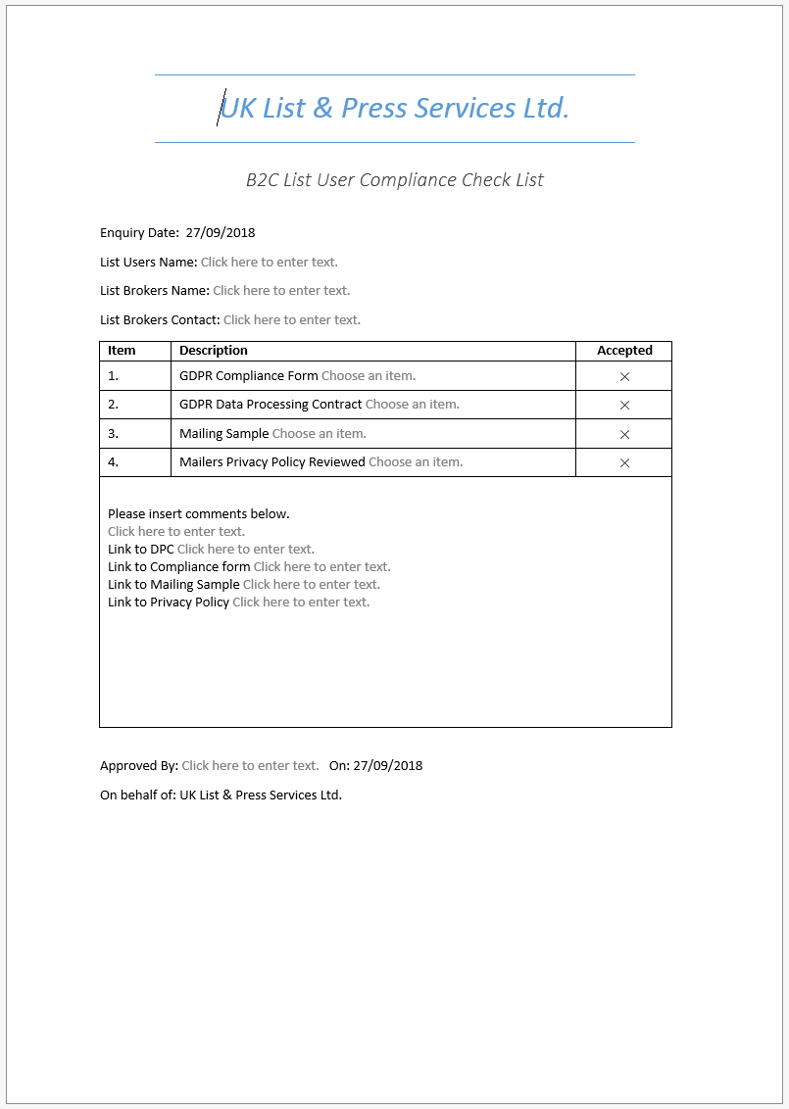
Due Diligence for List Users
When renting names to, or on behalf of a third party you are required to carry out due diligence to ensure, to the best of your ability that the List User complies with GDPR and the Data Protection Act 2018.
There are two documents which will assist this process, they are;
Appendix 3: Appendix 4:

Slide 22
Appendix 3 List User Compliance
This document needs to be completed by List Users (Controllers) and their List Broker/agency (Processors) when renting data from a 3rd party. This applies as follows.
When a List Users wishes to rent a postal marketing list.
All sections need to be completed.
All compliance documents to be filed electronically or otherwise for future reference.
Whenever List Users repeat order, you should seek assurance that the List Users processes remain unchanged, if any aspect of their processes have changed, this should be recorded.

Slide 23
Appendix 4 List User Compliance check list
This document is for internal purposes in order to ensure each step within the due diligence process is completed satisfactorily and the process is consistent for each list.
Special attention should be given to the List User Compliance form checking the following details.
All sections need to be completed!
Request mailing samples to be used and ensure these are compliant.
Check 1st Party, 3rd Party Opt-In and/or Opt-Out wording at data collection points is compliant. (See Appendix 5 for the DMA’s guidance on compliant copy).
Check Privacy Policies are GDPR compliant.
Check that the ICO registration number is correct and has not expired.
Ensure that they use secure methods for data transfer.
If processors and/or sub processors are named, request confirmation that current Data Processing Contracts are in place between all parties.

Slide 24
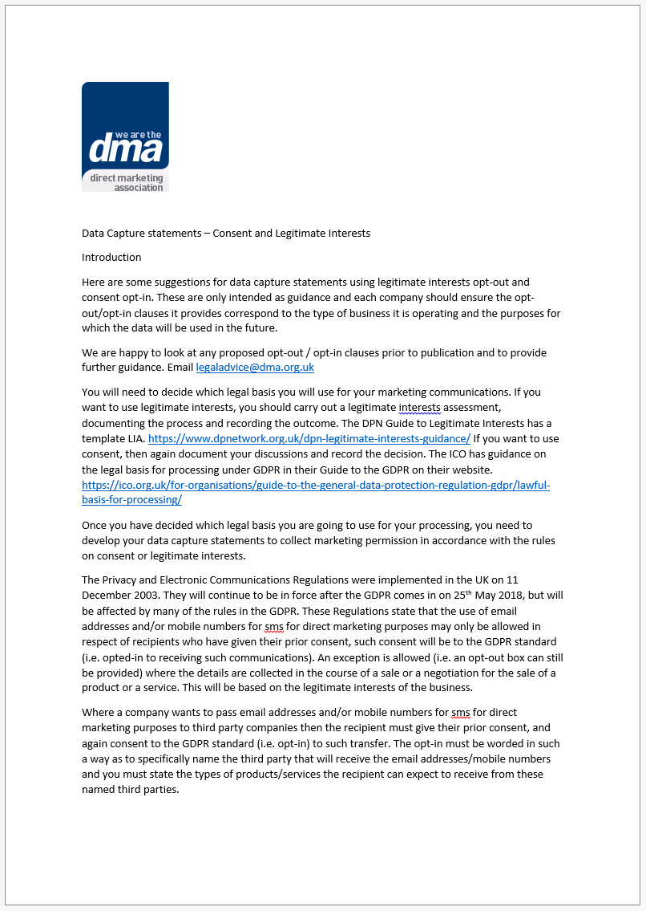
Appendix 5 DMA Data Capture Statement
This document gives data capture statements companies using Consent or Legitimate Interest as their legal basis for processing.
In almost all cases List Users or List Owners will be using Legitimate Interest for postal marketing, this being the case please refer to page three of this document.

Slide 25
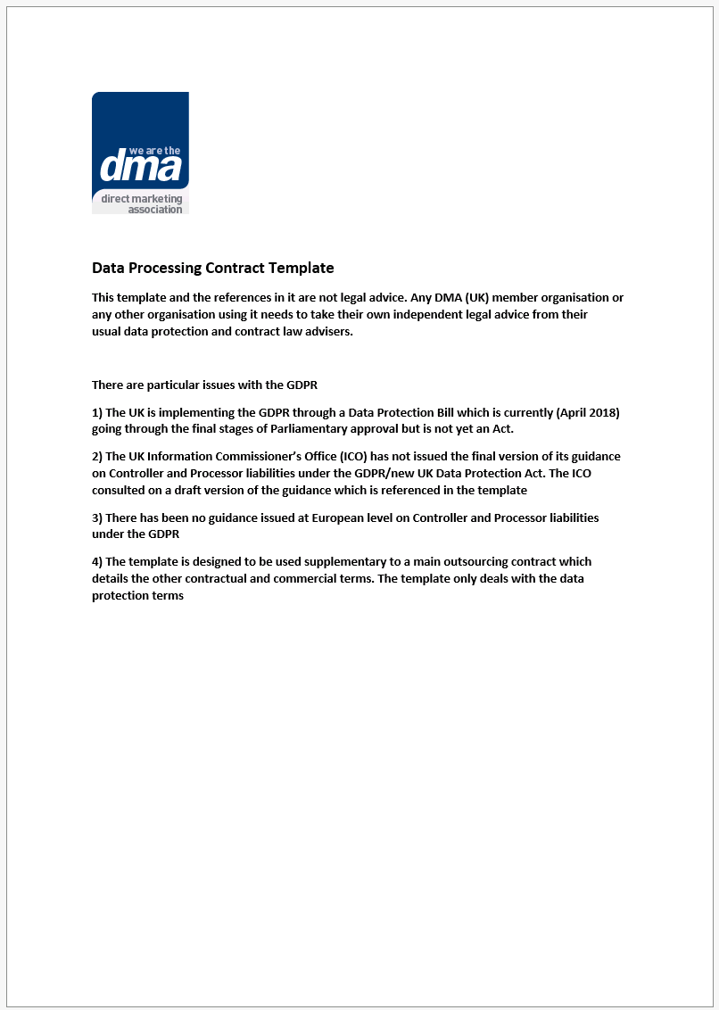
Appendix 6 DMA Data Processing Contract Template
Please use this template as the basis for a Data Processing Contract between a Data Controller and Data Processor.

Slide 26
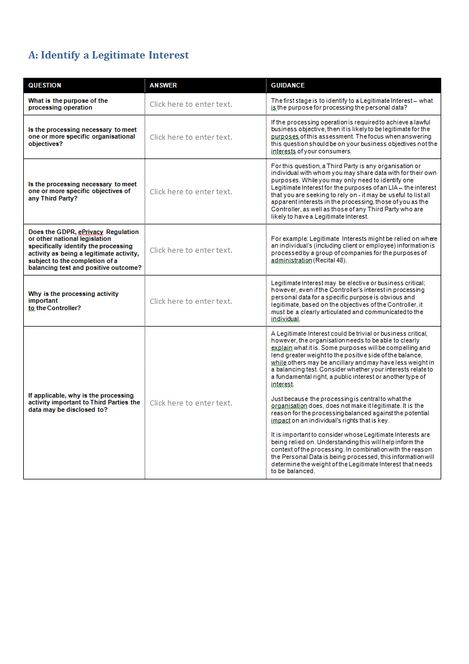
Appendix 7 Legitimate Interest Assessment Template
This is a copy of the LIA template produced by the Data Protection Network. This is a guide only and some sections may not all be relevant to all organisations.
LIA’s need to be carried out by both List Owners and List Users if using Legitimate Interest as their legal basis for processing.

Slide 27
Data Protection and Brexit
The General Data Protection Regulations (GDPR) will be absorbed into UK law at the point of exiting Europe. For further information please use the link below to read the ICO’s blog on advice for organisations.
https://ico.org.uk/for-organisations/data-protection-and-brexit/
Should the above link expire you can follow the ICO on Twitter or on LinkedIn for the latest information, further guidance is also available at https://ico.org.uk/for-organisations/

Slide 28
Summary
These guidelines have been produced in order to demonstrate how List Managers, Brokers and Agencies alike can adopt these common processes which will ensure that Due Diligence is carried out to the best of your ability. If during the due diligence process a Controller or Processor is considered not to be compliant, they should be provided with the relevant guidance, should an organisation not adopt best practice their request should be declined.

